Slide 1

Sales Dashboard using Power BI
Task 3 – Data Analyst Internship
ANJANI ADABALA

Slide 2
Objective of Dashboard
Create an interactive and visual dashboard for business stakeholders.
Use KPIs, trends, and filters to analyze sales performance.
Enable data-driven decision-making with clear insights.

Slide 3
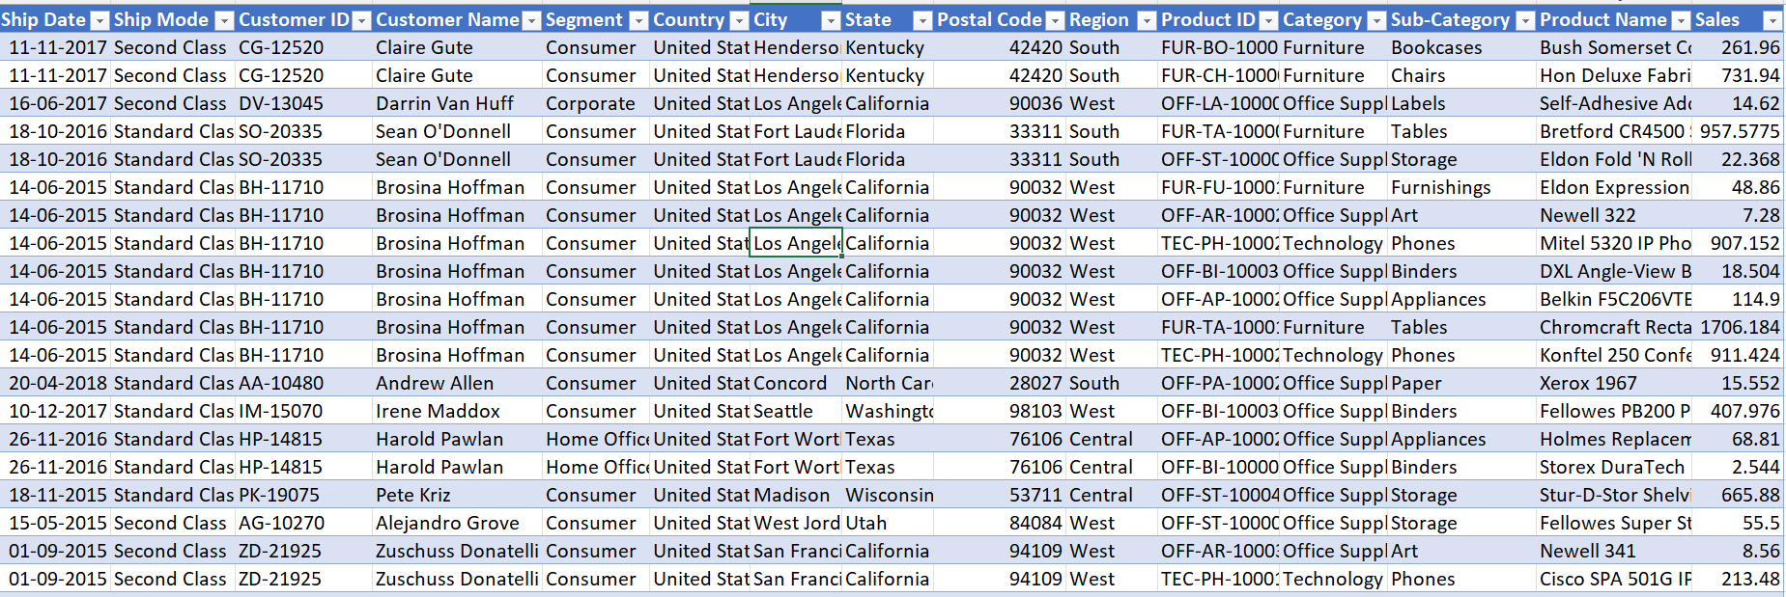
📂 Dataset Overview
Source: Kaggle

Slide 4
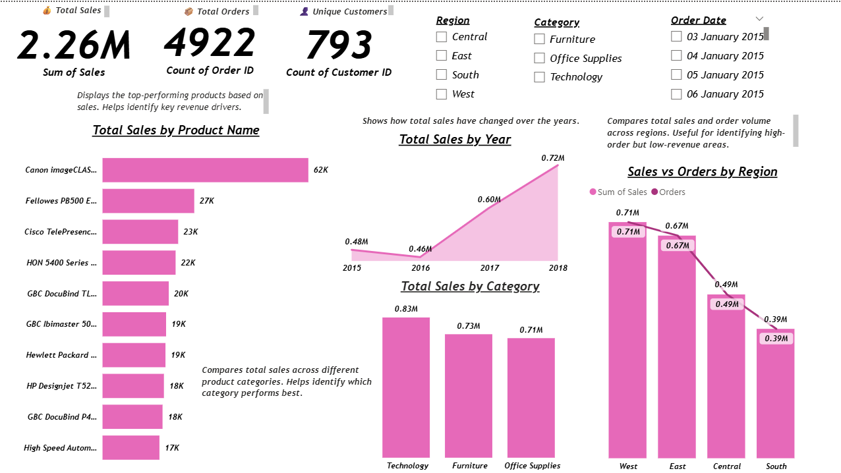
📸 Dashboard Preview

Slide 5
💡 Insights & Observations
The sales dashboard reveals a strong upward trend in revenue from 2015 to 2018, highlighting consistent business growth.
The Technology category emerged as the most profitable, significantly outperforming Furniture and Office Supplies.
Regionally, the West region leads in both sales and order volume, indicating a high-performing market.
Additionally, a small set of top products drive a large share of total revenue, with Canon image CLASS standing out as the best-selling item.
The insights provided can guide future decisions in product stocking, regional marketing, and strategic focus to maintain and boost profitability.

Slide 6
What I Learned
Working with slicers and filters in Power BI
Creating custom DAX measures
Designing a clean, user-friendly layout
Extracting business insights from visuals

Slide 7
THANK YOU
Thank you for reviewing my Power BI Dashboard.
Anjani Adabala
Data Analyst Intern (elevate labs)

